Slide 1
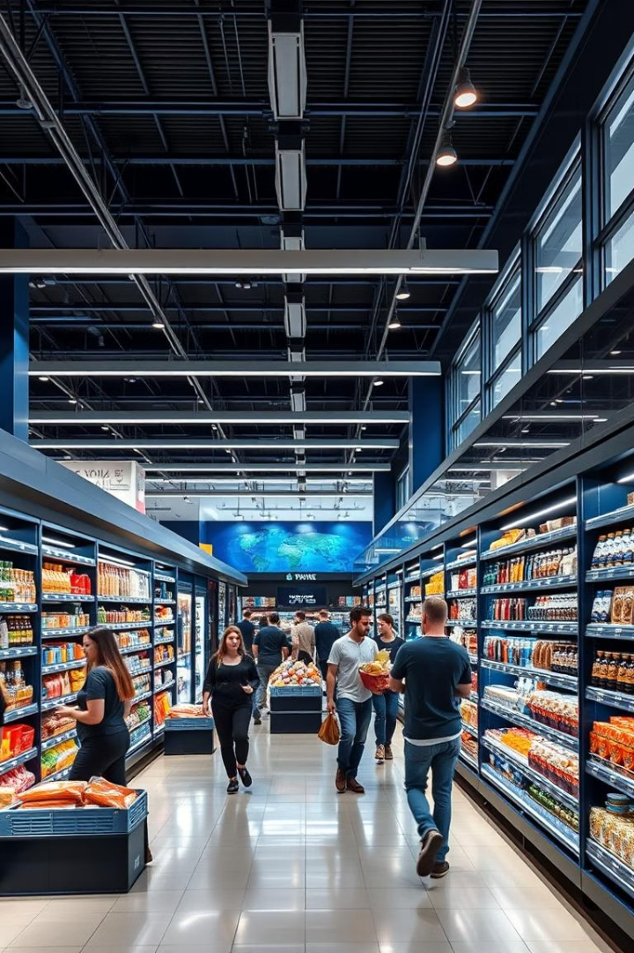

Sales and Customer Behavior Analysis in a Supermarket Chain
Data 200 – Applied Statistical Analysis
Presented by: [Your Names] | Date: [Insert Date]
by Patrik0

Slide 2

Problem Statement
Objective
Analyze how demographics, payment, and products impact total spending.
Key Questions
Do members spend more than normal customers?
Does gender influence total purchase amount?
Which payment method leads to higher sales?

Slide 3
Dataset Overview
Source: Kaggle
Key Variables
~1,000 records, 17 features
Customer Type, Gender
Payment Method, Product Line
Unit Price, Quantity, Total, Rating

Slide 4

Chosen Statistical Model
Model Selected
Why Regression?
Multiple Linear Regression to predict total purchase amount
Targets continuous variable; integrates multiple predictors
Alternative
ANOVA for categorical comparisons; less suited for prediction

Slide 5
Features Selected
Independent Variables
Dependent Variable
Gender
Total purchase amount
Customer Type
Payment Method
Product Line
Quantity
Unit Price

Slide 6

Hypotheses
1
Hypothesis 1 (Categorical)
H₀: Customer type has no effect on total spending.
H₁: Customer type affects total spending.
2
Hypothesis 2 (Continuous)
H₀: No linear relationship between unit price and total amount.
H₁: Significant relationship exists.

Slide 7

How We Will Do It
Data Encoding
Categorical features via one-hot encoding
Modeling Tool
Python libraries: statsmodels or sklearn
Validation Metrics
R² Score
p-values for significance
Residual plots
Significance Level
0.05

Slide 8

Expected Outcomes
Identify Key Factors
Predictive Insights
Marketing Simulation
Customer types and payment methods linked to spending
Forecast spending based on customer and product data
Targeted strategies based on analysis results

Slide 9

Next Steps
Finalize Features
Complete selection and train regression model
Validate Assumptions
Check linearity, normality, homoscedasticity
Build Application
Develop Python app for user inputs and predictions

